Slide 1
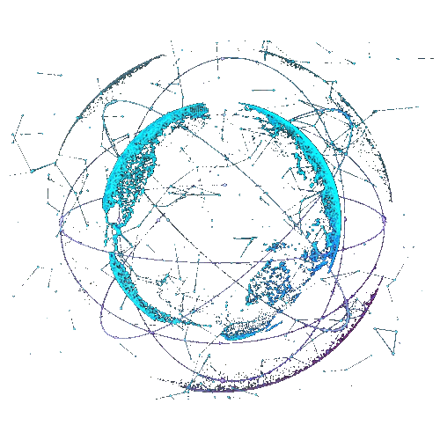



melab BD

Slide 2

melab BD

Slide 3
melab BD
melab BD

Slide 4
melab BD

Slide 5

melab BD

Slide 6
meLabBD
melab BD

Slide 8
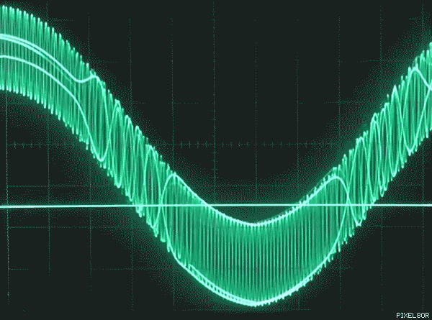



melab BD

